Slide 1


Book Recommendation System
TEAM MEMBERS :-
Ashwini S.
Akshay K.
Manoj K.
Bhabani B.
Anitha M.
Sathwik R.

Slide 2

content
Project Architecture
Introduction to Recommendation System
Dataset Details
Data Preprocessing And EDA
Visualization
Details about Recommendation Techniques
Model Selections
Deployment

Slide 3
Project Architecture
Datasets
-Import Libraries
-Load Datasets
Data Cleaning
-Missing Value Treatment
-Checking Duplicates
Data Preprocessing/EDA
-Construct an extra columns for locations
-Changes in the inappropriate blanks values in columns
Data Visualization
-Numerical Data Visualization
-Outliers Detection through Boxplot
Model Selection
Model Deployment

Slide 4




Introduction to Recommendation
Recommendation systems involve predicting user preferences for unseen items.
Recommendation systems have become popular with the increasing availability of millions of products online.
Recommending relevant products increases the customers interest and the sales of the company.
Examples-
Facebook- ‘People You May Know’
Netflix- ‘Other Movies You May Enjoy’
Amazon- ‘Customers Who brought this item’
And So on…

Slide 5
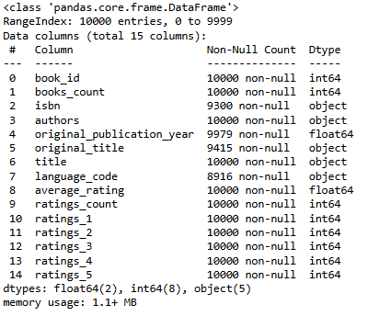
Datasets details
Books.csv – the dataset we are using in our project.
This dataset is extract using beautiful soap.
No. of Rows: 10,000
No. of Columns: 15

Slide 6
Data pre-processing
Null Values Treatments
Data Types
*Check Null Values
*Forward Fill 'isbn'
*Forward Fill 'original_publication_year'
*Fill 'original_title' with 'Unknown'
*Fill 'language_code' with 'XXX'
-Check Data Types
-Display Descriptive Statistics

Slide 7
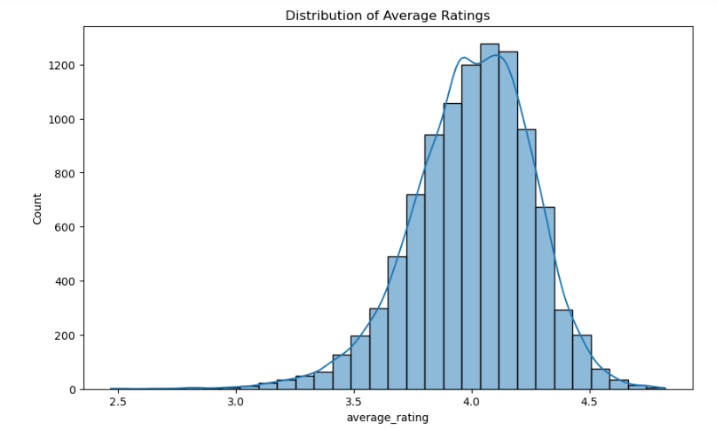
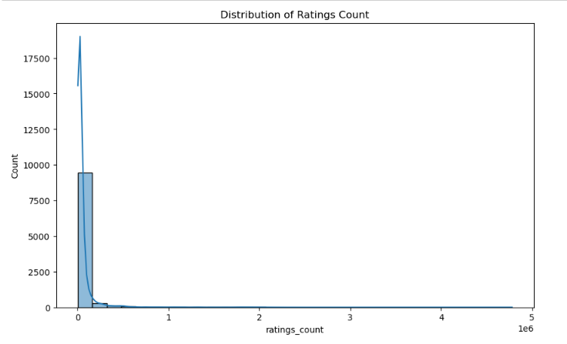
Data Visualization
Distribution of Average Ratings
Distribution of Ratings Count

Slide 8
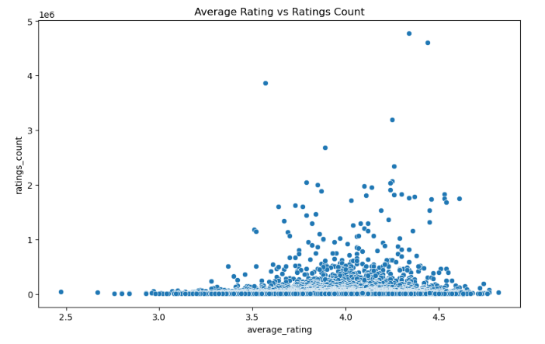
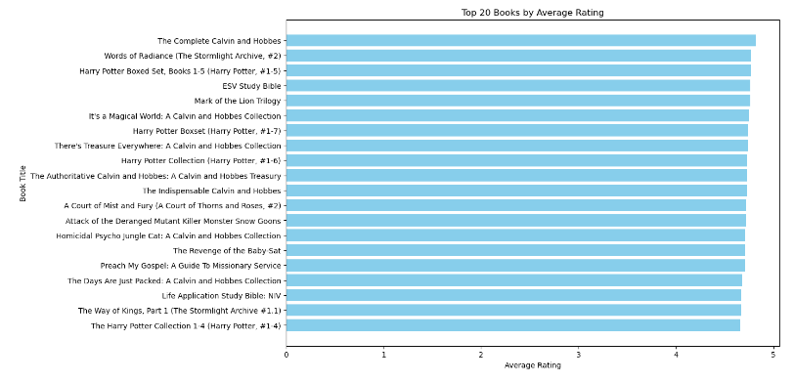
Scatter plot for comparing
Average Rating vs. Ratings Count
Top 20 Books
by Average Rating

Slide 9
Recommendation Techniques
Hybrid Recommendation:
Algorithm Overview:
Combines multiple recommendation algorithms.
Benefits:
More accurate recommendations.
More diverse recommendations.
How it Works:
Content-based and collaborative filtering combined.
Creates hybrid similarity matrix.
Leverages both content and user interactions.
Hybrid Recommendation
Content-Based
Collaborative Filtering

Slide 10
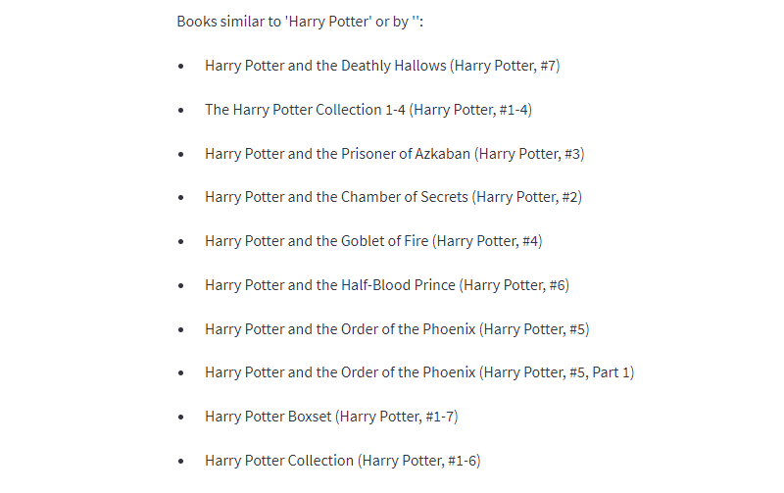

Slide 11
Deployment
Deployment is the process by which a ML model is moved from an offline environment and integrated into an existing production environment such as a live application.
It is a critical step that must be completed in order for a model to serve its intended purpose and solve the challenges it is designed.
Here, we are using ‘Stremlit’ for deploying our application.

Slide 12
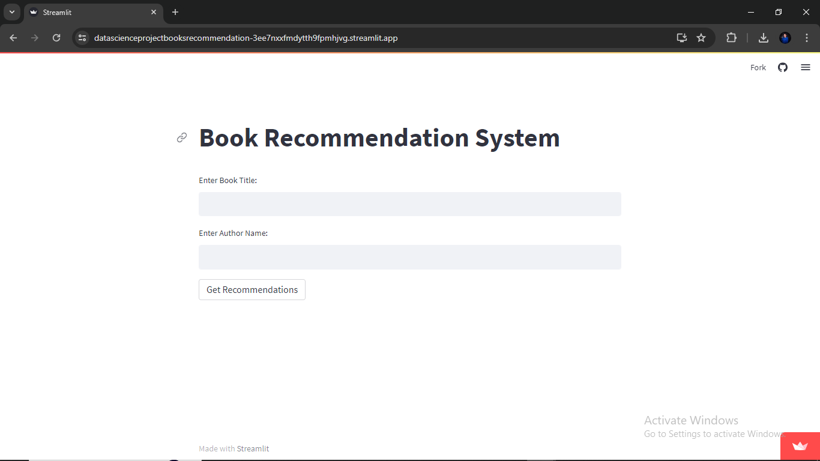

Slide 13


Challenges in project
Data Extraction Difficulties:
Initial Issues with Beautiful Soup:
Problem: Difficulty in extracting datasets from Amazon Books website.
Solution: Team learned and implemented advanced scraping techniques.
Complexity in Exploratory Data Analysis (EDA):
Interesting but Challenging:
Variable Selection: Identifying the most relevant variables for analysis.
Effective Visualization: Creating impactful and insightful visualizations.
Model Building Hurdles:
Accuracy Challenge:
Trial and Error: Built 5-6 models.
Final Selection: Chose the model that provided the most accurate recommendations.

Slide 14
references
Pandas documentation Link- https://pandas.pydata.org/docs/
Matplotlib documentation- https://matplotlib.org/stable/index.html
Streamlit documentation- https://docs.streamlit.io/
https://www.kaggle.com/

Slide 15

Any Questions??

Slide 16

THANK
YOU!!!!!

